Slide 1
Creating the Server-Side Scripts III
Week 07.

Slide 2
Objectives
Demonstrate how to connect to database server using Node.js;
Demonstrate how to execute SQL commands in Node.js;
Demonstrate how to create Web API;
Demonstrate how to route HTTP requests in Node.js.

Slide 3
Tools Required
MySQL DB
MySQL Workbench
Visual Studio Code
Chrome Browser
Nodejs
Postman

Slide 4
Creating Add Comment Feature

Slide 5
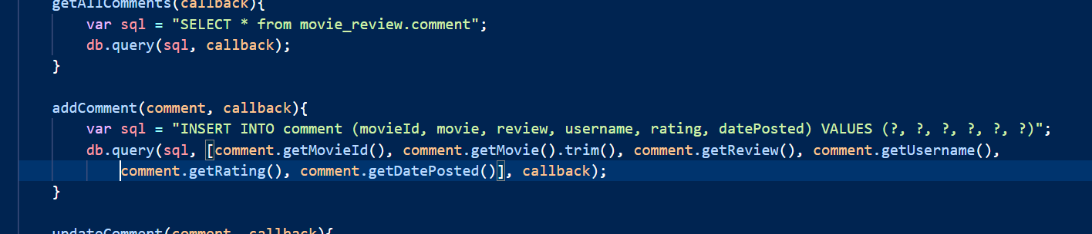
Creating Add Comment Feature
Watch Week 7 demo here
Open the CommentsDB.js file that you created in Visual Studio Code.
Add the following addComment() function.
The question marks here represent placeholders for the value of each field. It has to match the number of field values you want to insert.
The parameters here consist of an array of values for each of the fields in the comment table. The values are gotten from the Comment object that is passed in as a parameter in the addComment() function. Note that the order of the values must follow the order of the fields in the SQL statement.

Slide 6
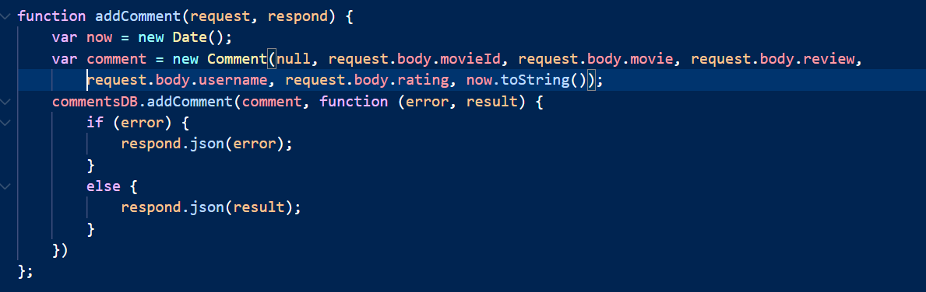

Creating Add Comment Feature
Open the commentController.js file that you created in Visual Studio Code.
Add the following addComment() function.
Remember to export the new function

Slide 7
Creating Add Comment Feature
Next, open the server.js file and add the line of code to the existing routes that you already have
This line of code will be executed when the HTTP ‘POST’ method is used.

Slide 8
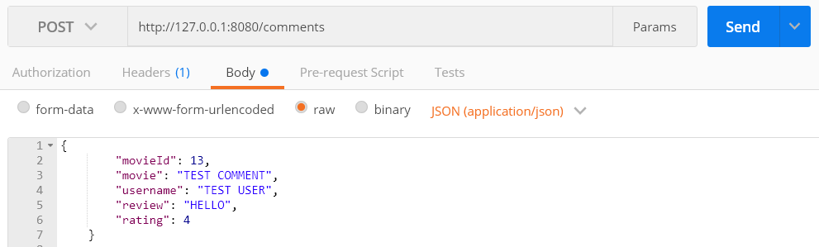
Test It!
Now restart your Node.js server and test your API in Postman

Slide 9
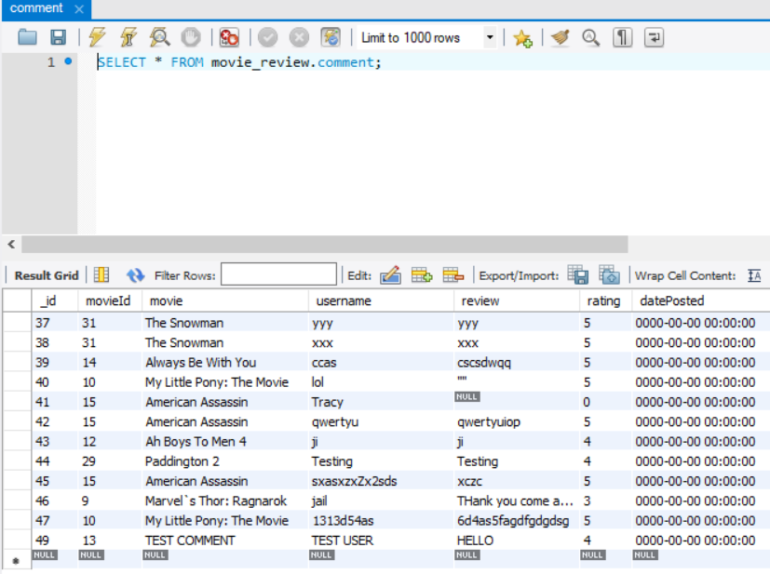
Test It!
Check that you have successfully inserted the data into the comment table in MySQL Workbench

Slide 10
Creating UPDATE Comment Feature

Slide 11
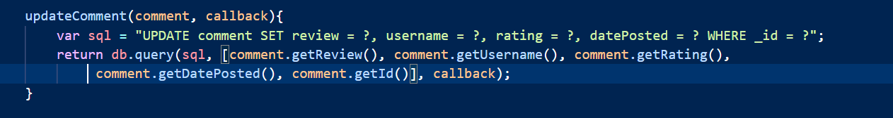
Creating Update Comment Feature
Open the CommentsDB.js file that you created in Visual Studio Code.
Add the following updateComment() function.
Similarly, the question marks here represent placeholders for the value of each field. The values for each field is defined in the array named “values”.
Similarly, the question marks here represent placeholders for the value of each field. The values for each field is defined in the array named “values”.

Slide 12
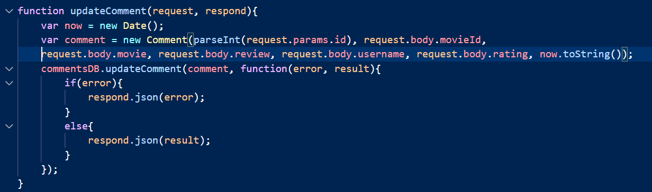
Creating Update Comment Feature
Open the commentController.js file that you created in Visual Studio Code.
Add the following updateComment() function.
Remember to export the new function
The request.params from the request parameter contains all values in the URL pattern that are specified in the routes. For example, if the pattern is “/comments/:id” and the actual URL is “/comments/32”, then the value of id is 32. The pattern will be explained in the next slide.

Slide 13
Creating Update Comment Feature
Next, open the server.js file and add the highlighted line of code.
This time, we will change the URL pattern for updating comment. This is because we need the comment id in order to know which comment in the database is to be updated. For example, if we are updating comment number 49, the URL will look like this:
http://localhost:8080/comments/49
This line of code will be executed when the HTTP ‘PUT’ method is used.

Slide 14
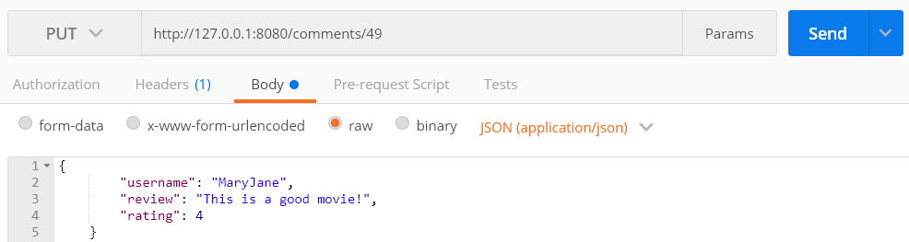
Test It!
Now restart your Node.js server and test your API in Postman
Use the id of the comment that you want to update (refer to your comments table)

Slide 15
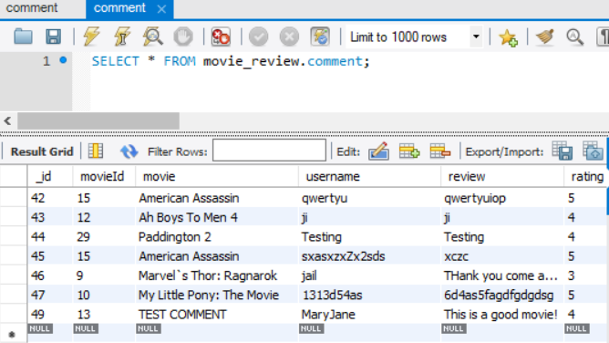
Test It!
Check that you have successfully updated the data into the comment table in MySQL Workbench

Slide 16
Creating Delete Comment Feature

Slide 17
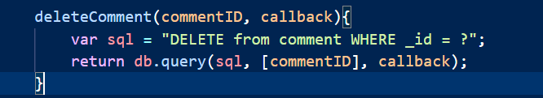
Creating Delete Comment Feature
Open the CommentsDB.js file that you created in Visual Studio Code.
Add the following deleteComment() function.

Slide 18
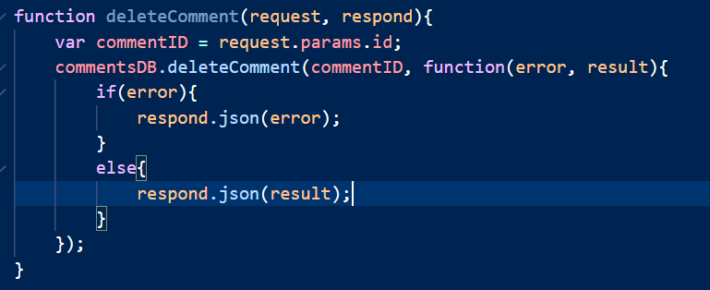
Creating Update Comment Feature
Open the commentController.js file that you created in Visual Studio Code.
Add the following deleteComment() function.
Remember to export the new function
The request.params from the request parameter contains all values in the URL pattern that are specified in the routes. For example, if the pattern is “/comments/:id” and the actual URL is “/comments/32”, then the value of id is 32. The pattern will be explained in the next slide.

Slide 19
Creating Delete Comment Feature
Next, open the server.js file and add the highlighted line of code.
This time, we will change the URL pattern for updating comment. This is because we need the comment id in order to know which comment in the database is to be deleted. For example, if we are deleting comment number 49, the URL will look like this:
http://localhost:8080/comments/49
This line of code will be executed when the HTTP ‘DELETE’ method is used.

Slide 20
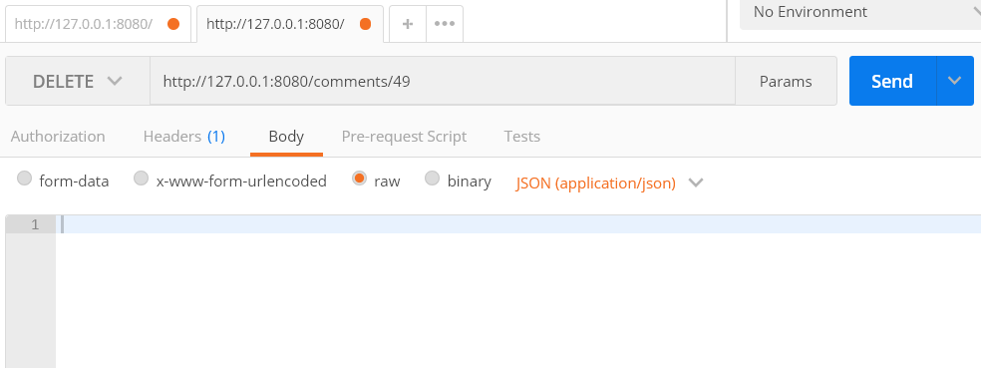
Test It!
Now restart your Node.js server and test your API in Postman
Use the id of the comment that you want to update (refer to your comments table)

Slide 21
Test It!
Check that you have successfully deleted the data into the comment table in MySQL Workbench

Slide 22
Next Episode
In the next episode, you will learn how to create the Movie review web pages.

Slide 23
Reference
TutorialsPoint – Learn MySQL
https://www.tutorialspoint.com/mysql/index.htm
W3Schools – Node.js MySQL Select From
https://www.w3schools.com/nodejs/nodejs_mysql_select.asp
expressJS – Get URL and POST Parameters
https://scotch.io/tutorials/use-expressjs-to-get-url-and-post-parameters
TutorialsPoint – Request Object
https://www.tutorialspoint.com/nodejs/nodejs_request_object.htm
expressJS Documentation
http://expressjs.com/en/api.html

Slide 24
The End

